Slide 1
The Road Ahead
Rebecca M. Brewster
President and COO
American Transportation Research Institute

Slide 2
ATRI
Trucking industry’s not-for-profit research organization
Safety
Mobility
Economic Analysis
Technology
Environment
www.TruckingResearch.org

Slide 3














Board of Directors

Slide 4
































Research Advisory Committee

Slide 5
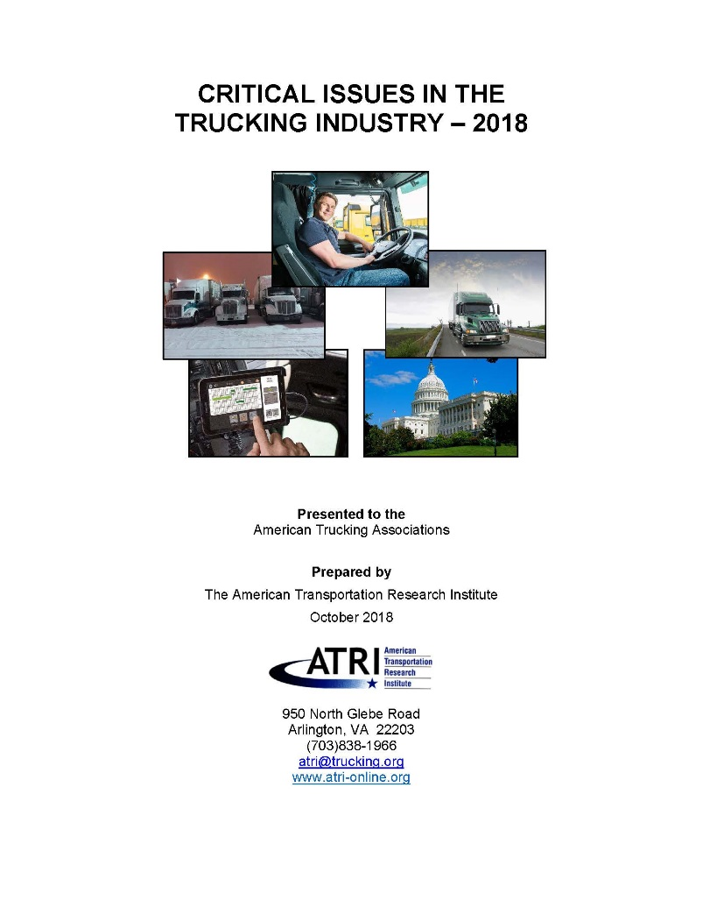
2018 Top Industry Issues
Driver Shortage (1)
Hours-of-Service (3)
Driver Retention (5)
ELD Mandate (2)
Truck Parking (4)
CSA (6)
Driver Distraction (8)
Transportation Infrastructure /Congestion/ Funding (9)
Driver Health and Wellness (10)
Economy (11)

Slide 6
Top Issues Drivers vs. Carriers
Motor Carrier Execs
Commercial Drivers
Hours-of-Service
Truck Parking
ELD Mandate
Driver Distraction
Driver Retention
CSA
Driver Health/Wellness
Transportation Infrastructure /Congestion/ Funding
Driver Shortage
Automated Truck Technology
Driver Shortage
Driver Retention
Hours-of-Service
Transportation Infrastructure /Congestion/ Funding
ELD Mandate
CSA
Driver Distraction
Tort Reform
Truck Parking
Federal Preemption of State Regulation of Interstate Trucking (F4A)

Slide 7
Truck Driver Age Demographics
Notes:
7

Slide 8
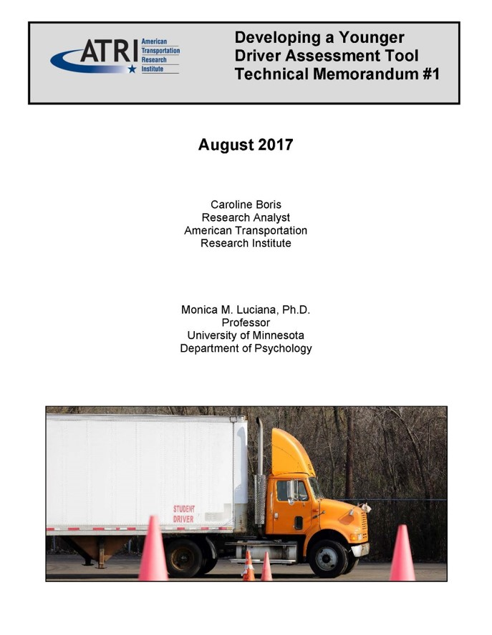
Driver Safety Assessment Tool
Is it possible to identify younger individuals with the same characteristics of safe, older drivers?
Prior studies focus on relationship between a single driver characteristic and safety outcomes
ATRI’s research investigated the relationship between multiple driver characteristics and safety outcomes

Slide 9
Driver Safety Assessment Tool
Driver safety in commercial and non-commercial drivers can be reliably predicted by a number of individual factors:
  Personality traits
  Health status
  Driving experience
  Age
  Cognitive ability
  Attitudes regarding safety
Recently completed – beta test tool on ~100 drivers of varying ages, safety performance

Slide 10
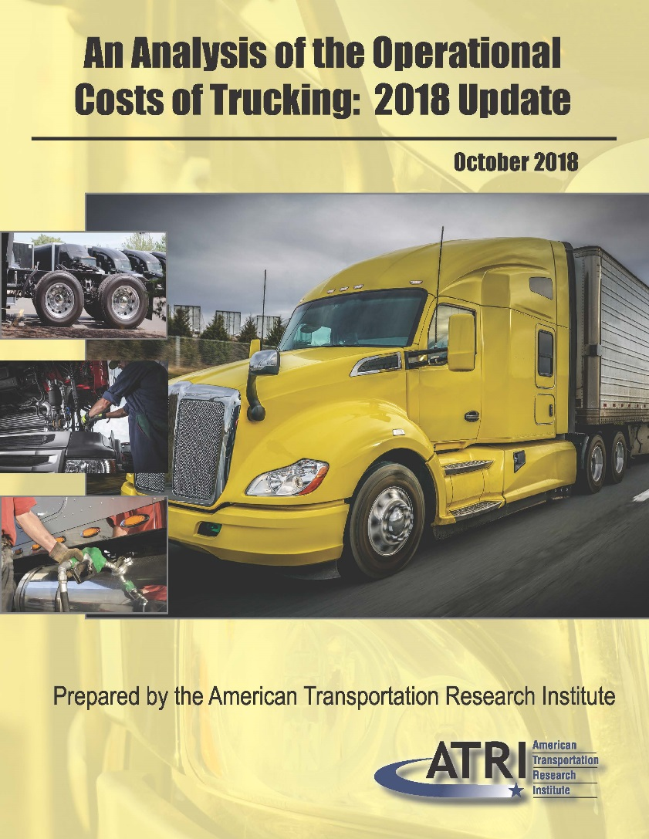
Operational Costs of Trucking
Collects and analyzes real-world motor carrier operational data
Covers data from 2008-2017
Calculates costs by mile and by hour
Sector, regional analyses included

Slide 11
Operational Costs of Trucking
Average Carrier Costs per Mile
Motor Carrier Costs | 2013 | 2014 | 2015 | 2016 | 2017
Vehicle-based
Fuel Costs | $0.645 | $0.583 | $0.403 | $0.336 | $0.368
Truck/Trailer Lease or Purchase Payments | $0.163 | $0.215 | $0.230 | $0.255 | $0.264
Repair & Maintenance | $0.148 | $0.158 | $0.156 | $0.166 | $0.167
Truck Insurance Premiums | $0.064 | $0.071 | $0.074 | $0.075 | $0.075
Permits and Licenses | $0.026 | $0.019 | $0.019 | $0.022 | $0.023
Tires | $0.041 | $0.044 | $0.043 | $0.035 | $0.038
Tolls | $0.019 | $0.023 | $0.020 | $0.024 | $0.027
Driver-based
Driver Wages | $0.440 | $0.462 | $0.499 | $0.523 | $0.557
Driver Benefits | $0.129 | $0.129 | $0.131 | $0.155 | $0.172
TOTAL | $1.676 | $1.703 | $1.575 | $1.592 | $1.691

Slide 12
Operational Costs of Trucking
Motor Carrier Costs | 2016 – 2017 Change
Vehicle-based
Fuel Costs | 9.3%
Truck/Trailer Lease or Purchase Payments | 3.3%
Repair & Maintenance | 0.3%
Truck Insurance Premiums | 0.0%
Permits and Licenses | 6.4%
Tires | 7.8%
Tolls | 9.9%
Driver-based
Driver Wages | 6.6%
Driver Benefits | 11.2%
TOTAL | 6.2%

Slide 13
Operational Costs of Trucking
Motor Carrier Costs | 2017 Share of Total Cost
Vehicle-based
Fuel Costs | 22%
Truck/Trailer Lease or Purchase Payments | 16%
Repair & Maintenance | 10%
Truck Insurance Premiums | 4%
Permits and Licenses | 1%
Tires | 2%
Tolls | 2%
Driver-based
Driver Wages | 33%
Driver Benefits | 10%

Slide 14
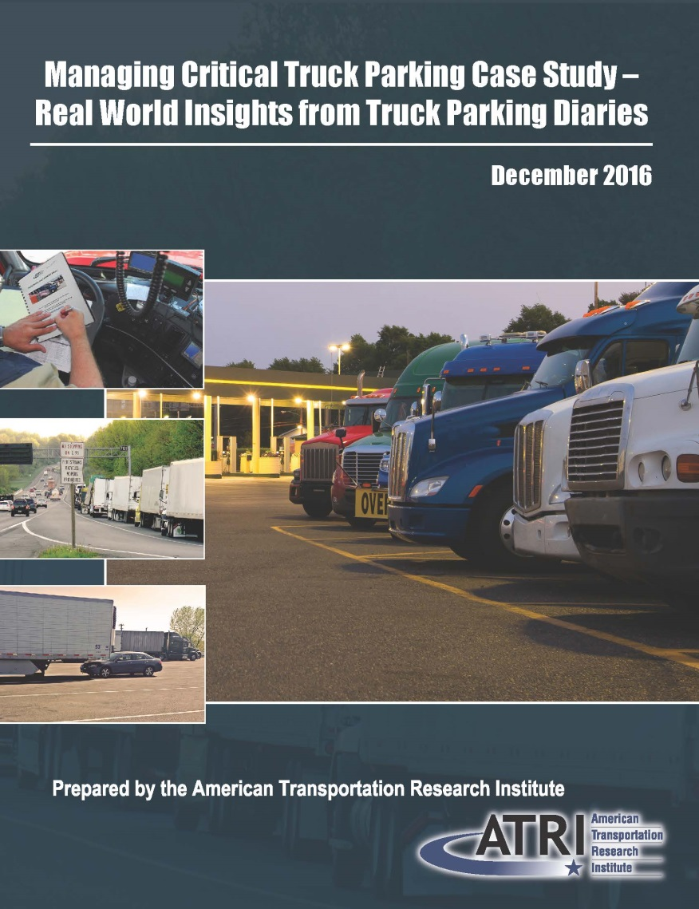
Truck Parking Diary Report
Truck Parking Diaries
Drivers kept 14 days of parking activity
Includes when, where, how long to find a spot, how many spots occupied by non-CMVs, lost productivity, etc
148 completed diaries were returned between June and September 2016
  2,035 days of truck parking activity
  4,763 unique stops

Slide 15
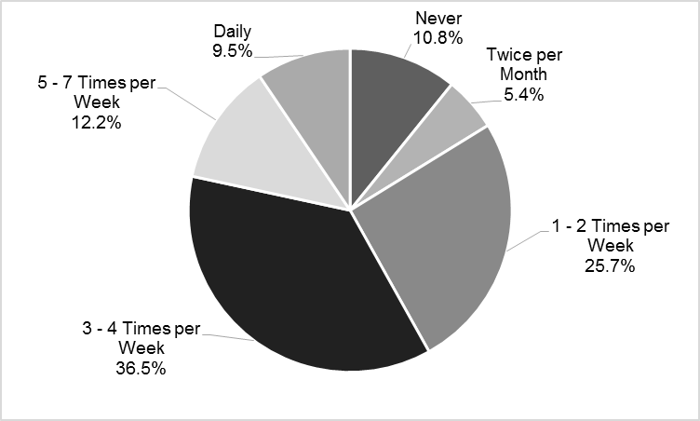
Frequency of Unauthorized/Undesignated Parking

Slide 16
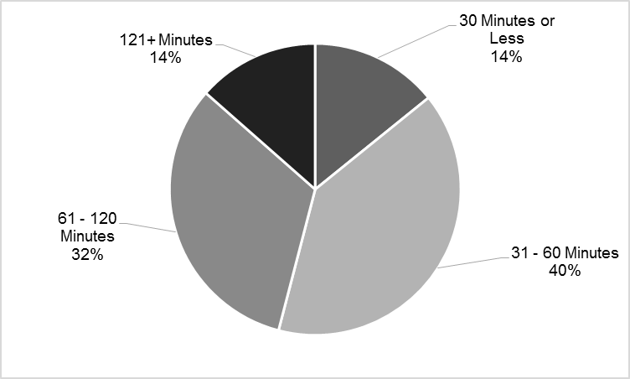
Average Remaining Drive Time
Average = 56 minutes/day
Opportunity Cost = $4,600 annually

Slide 17
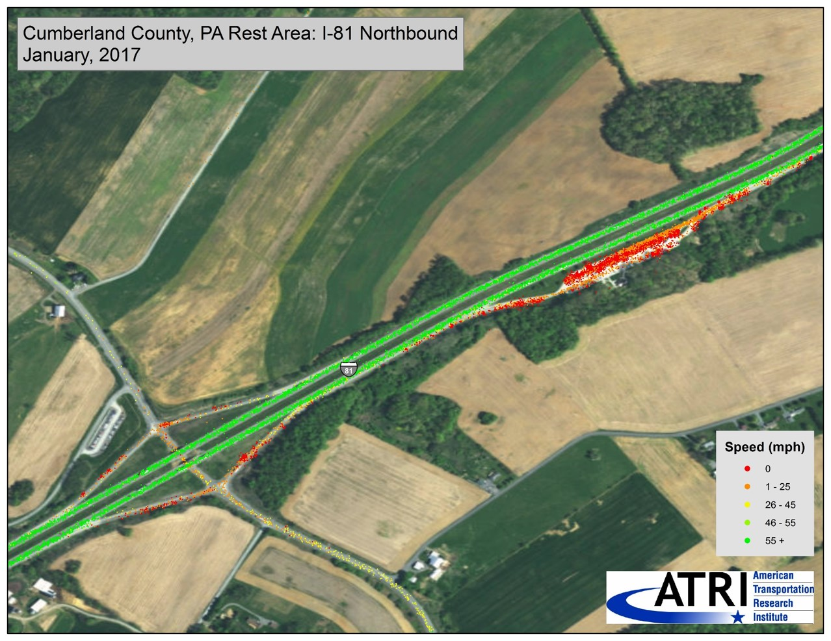
No Vacancy

Slide 18
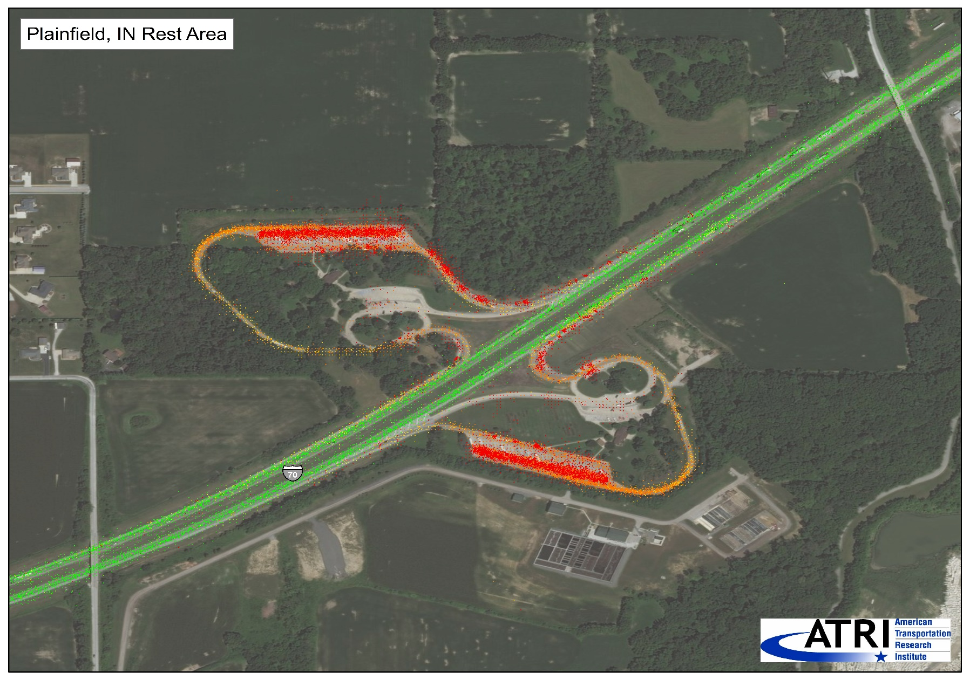
No Vacancy

Slide 19
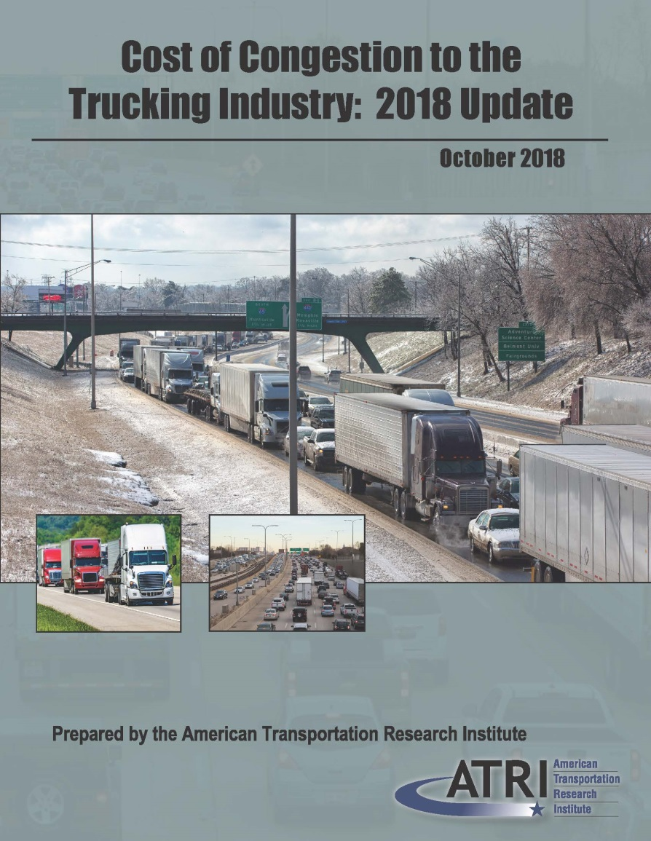
Cost of Congestion
Congestion on U.S. NHS cost trucking industry $74.5B in 2016
Lost productivity = 1.2 billion hours
  Equates to 425,533 commercial drivers sitting idle for entire year

Slide 20
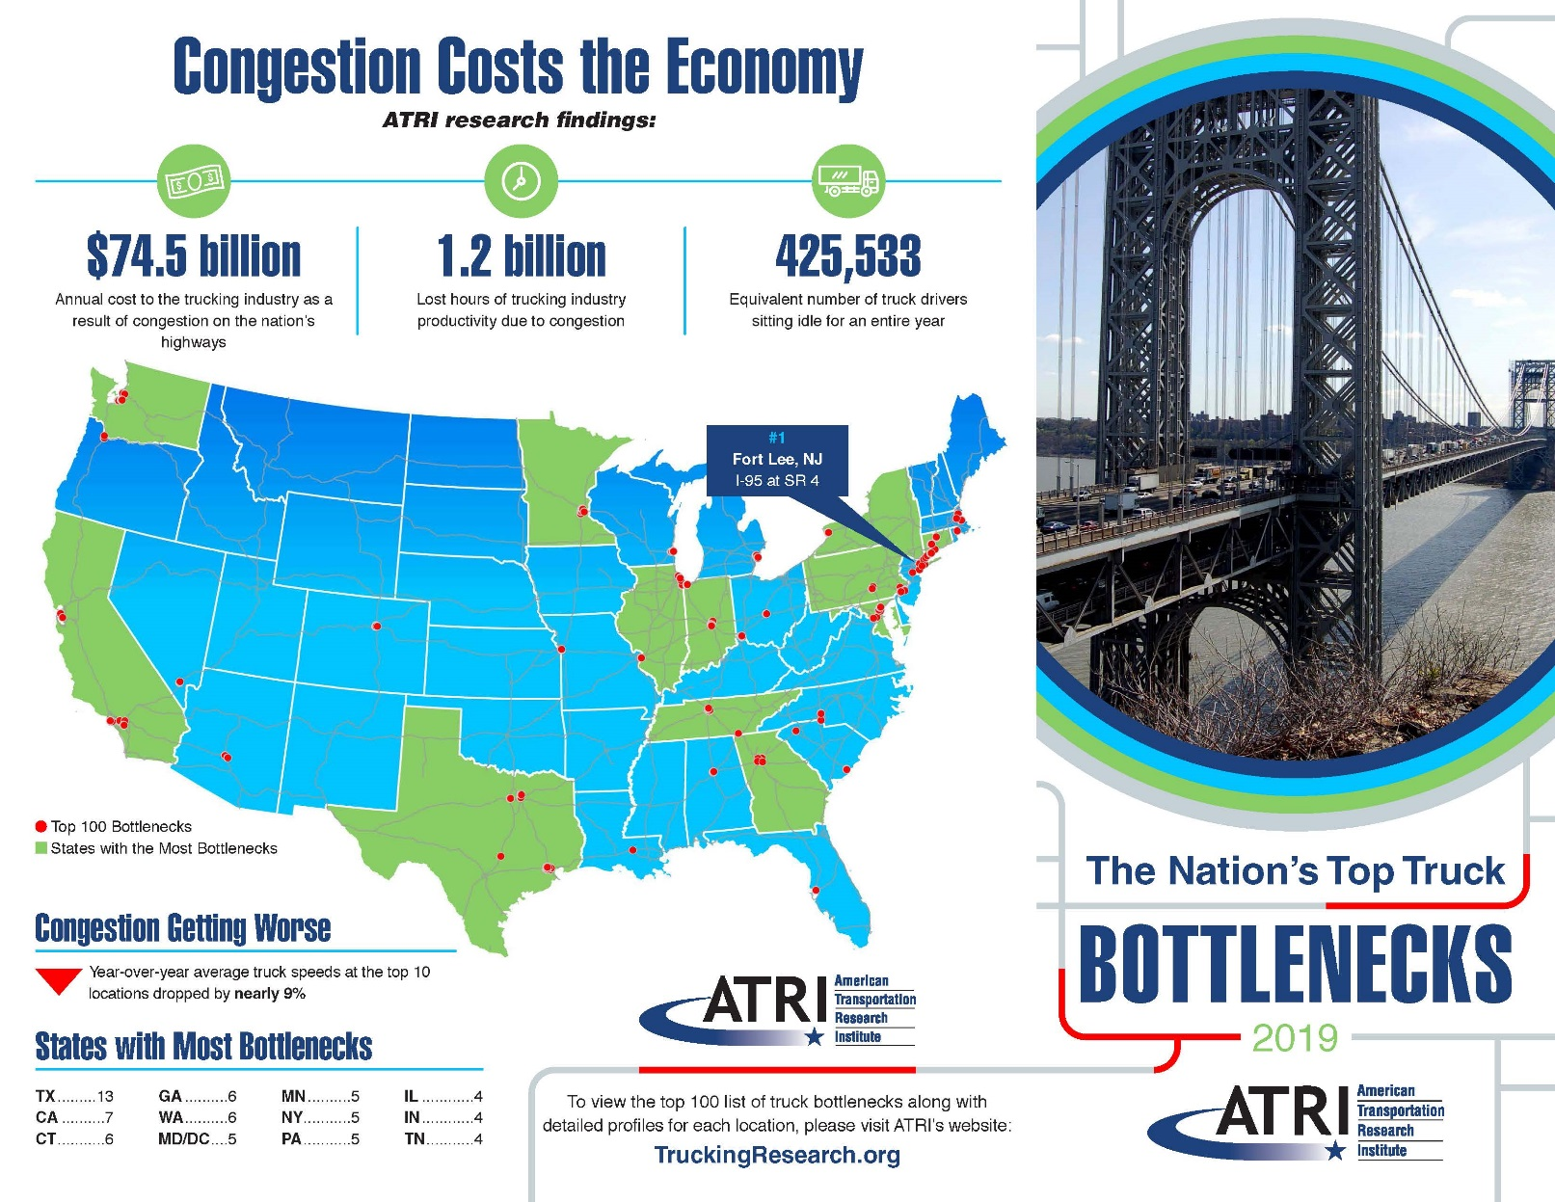

Slide 21
2019 Top 10 Truck Bottlenecks
Rank | Location | Average Peak Speed | Y-o-Y Change in Average Peak Speed
1 | Fort Lee, NJ: I-95 at SR 4 | 23.0 | -7.65%
2 | Atlanta, GA: I-285 at I-85 (North) | 22.9 | -7.35%
3 | Atlanta, GA: I-75 at I-285 (North) | 27.4 | -9.91%
4 | Los Angeles, CA: SR 60 at SR 57 | 34.5 | 1.05%
5 | Houston, TX: I-45 at I-69/US 59 | 24.2 | -9.46%
6 | Cincinnati, OH: I-71 at I-75 | 36.2 | -7.42%
7 | Chicago, IL: I-290 at I-90/I-94 | 17.6 | -16.74%
8 | Nashville, TN: I-24/I-40 at I-440 (East) | 28.1 | -11.75%
9 | Atlanta, GA: I-20 at I-285 (West) | 38.3 | -5.06%
10 | Los Angeles, CA: I-710 at I-105 | 26.8 | -12.35%

Slide 22
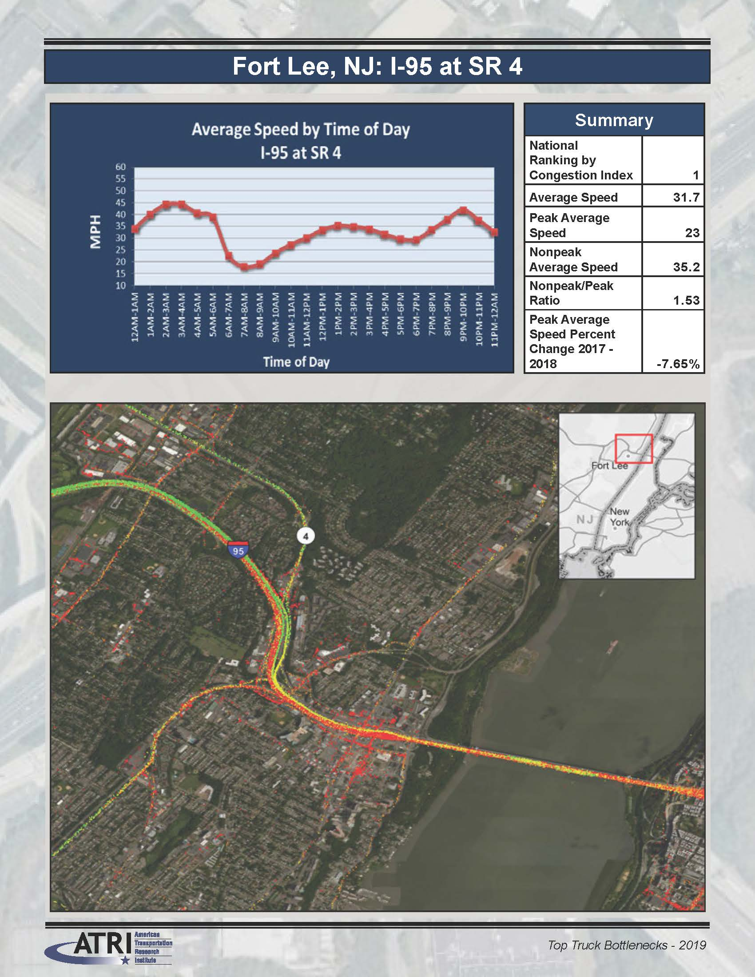
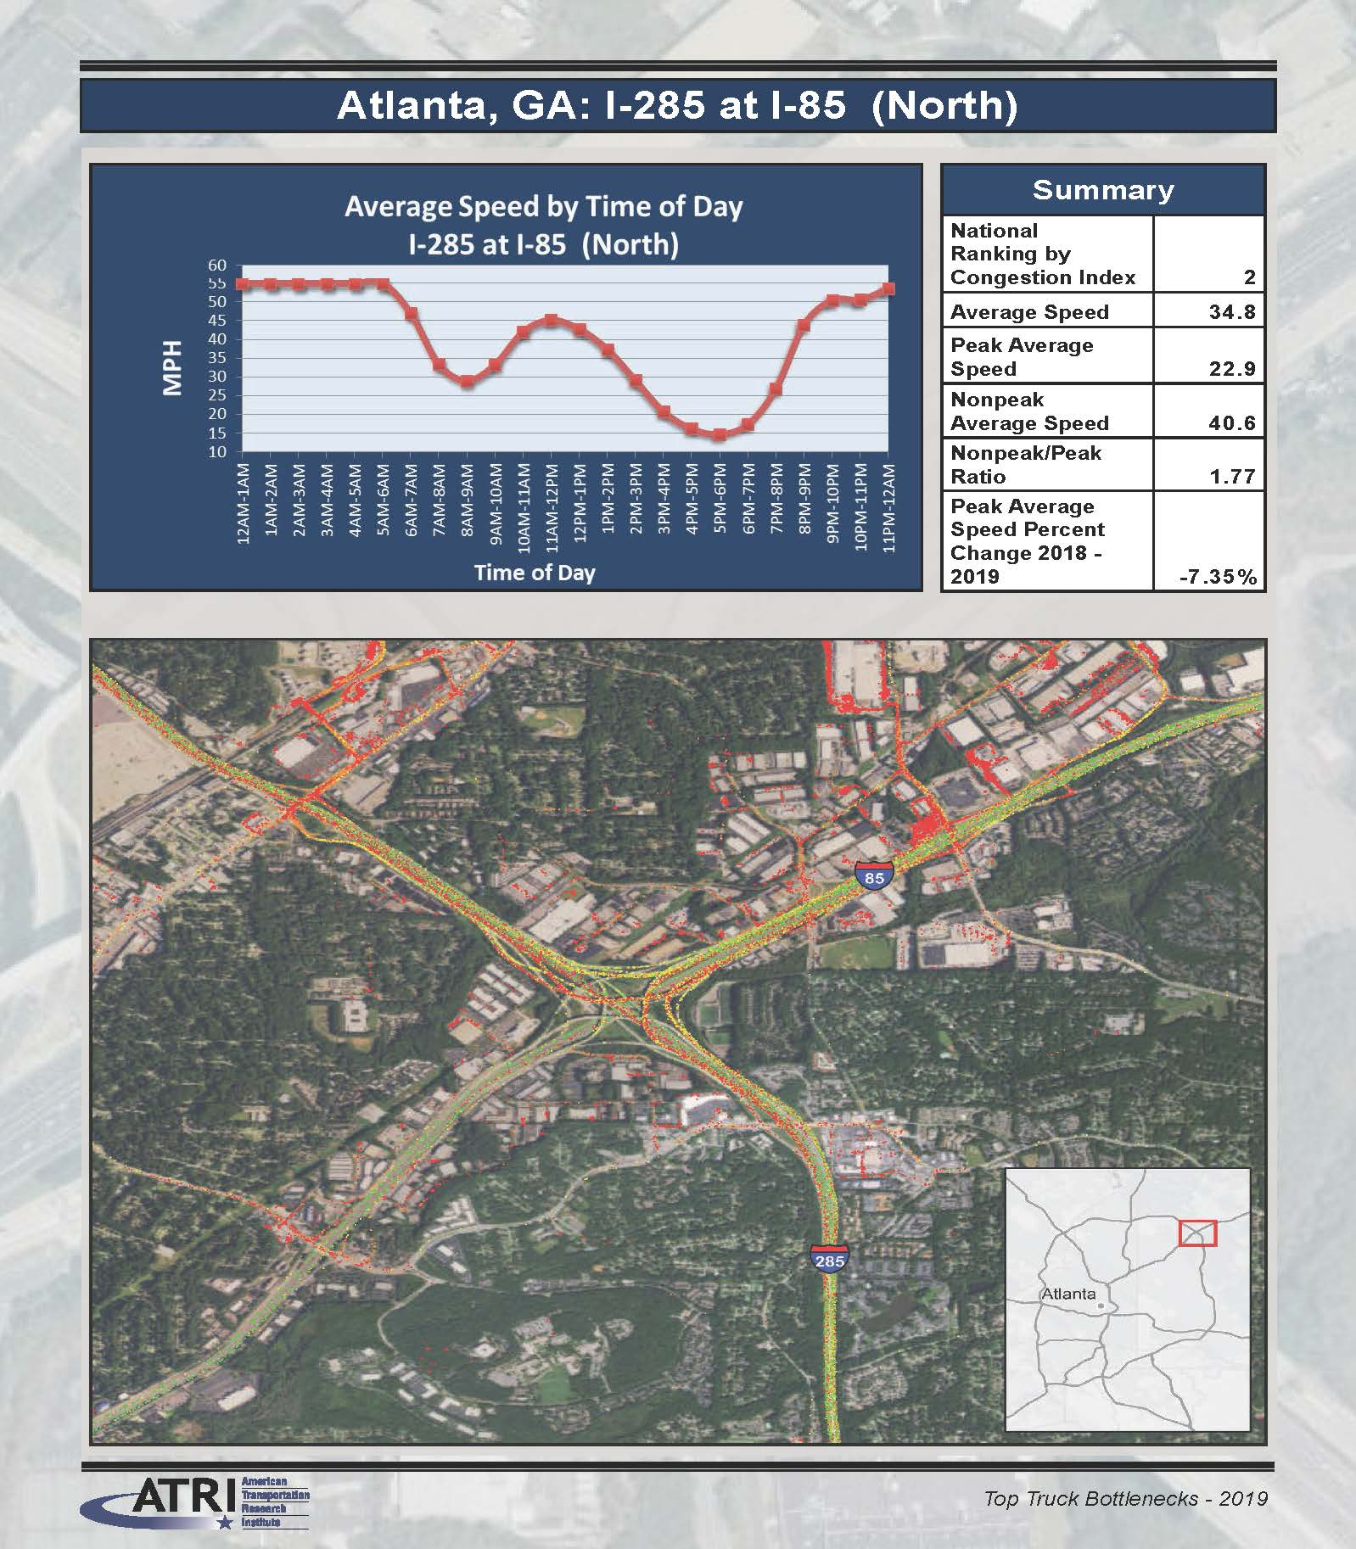

Slide 23
Fixing the 12% Case Study
Quantifies fuel consumption and emissions impacts of congestion
In 2016, congestion increased trucking’s fuel consumption by 6.87 billion gallons; costing $15.74 billion
Notes:
23

Slide 24
Fixing the 12% Case Study
Modeled current conditions to 55 mph scenario
Reduced emissions & fuel consumption by:
17%↓ PM2.5
8%↓ CO2/Fuel
5.5%↓ NOx
Notes:
24

Slide 25
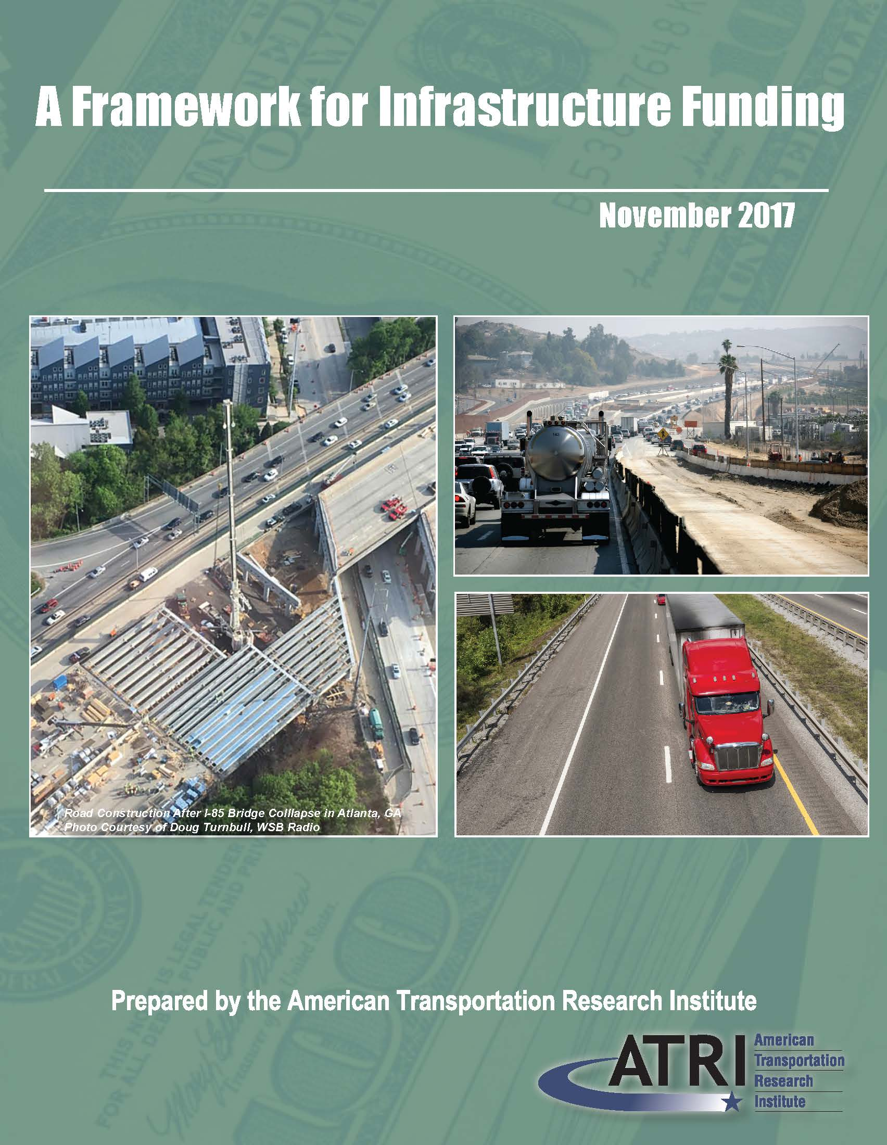
Transportation Infrastructure Funding
Analyzes/scores six different approaches for federal transportation infrastructure revenue
  Fuel Tax
  Registration Fees
  General Fund Allocations
  Financing
  VMT Tax
  Tolling

Slide 26
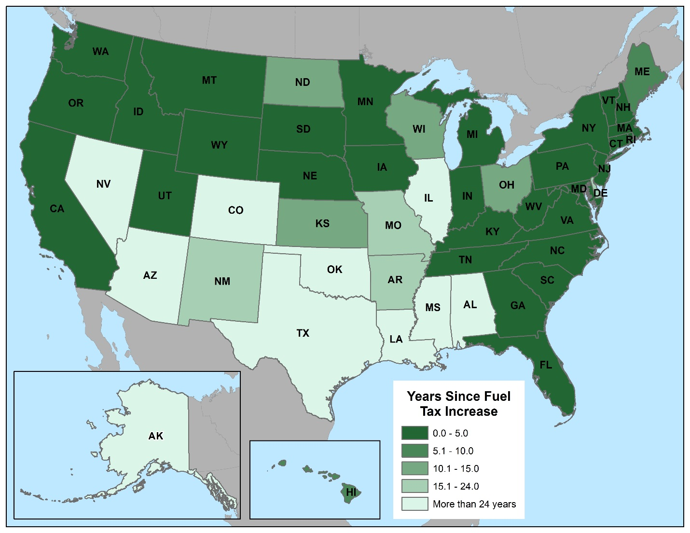
States Increasing Fuel Tax

Slide 27
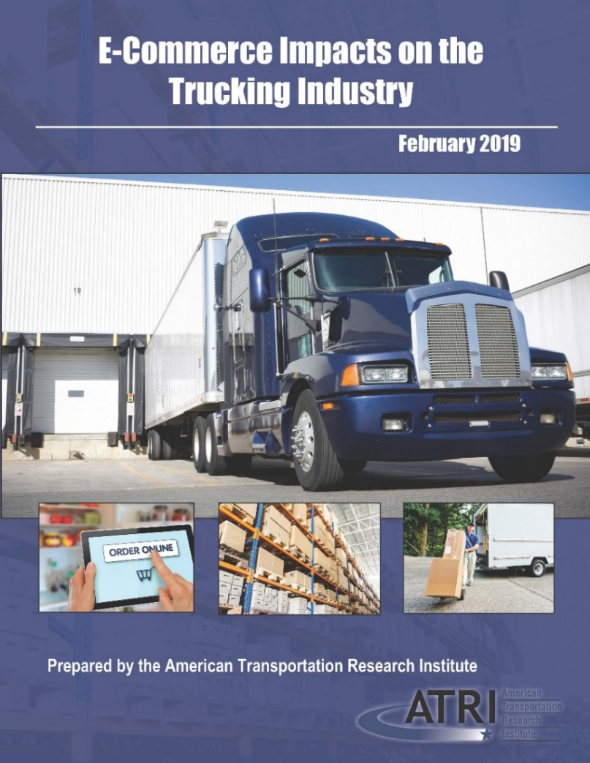
E-Commerce Impacts on Trucking Industry
Examines growth of e-commerce, impacts on trucking
E-commerce sales grew from less than 1% of total U.S. retail sales in 1999 to more than 9% in 2017

Slide 28
E-Commerce Growth
E-commerce annual growth of 13-16% over the last five years
  Outpacing 1-5% annual growth in traditional retail
Retailers decentralizing distribution / fulfillment networks to bring inventory closer to consumers
2,130 fewer department stores, 385,000 fewer jobs at those stores in 2017 vs. 2015
1,937 more courier services operating, 85,000+ new employees hired in the sector during this time period

Slide 29
Trucking Industry Impacts
“Last Mile Fulfillment Centers” represented 73% of industrial real estate market in 2017
Single-unit truck registrations increased by 7.8% between 2007-2016
  Compared to 4.4% growth in combination truck
Average trip lengths decreased 37% since 2000; urban VMT increased
Intrastate and local hauls for e-commerce could serve as training opportunity for 18-20-year-old drivers

Slide 30
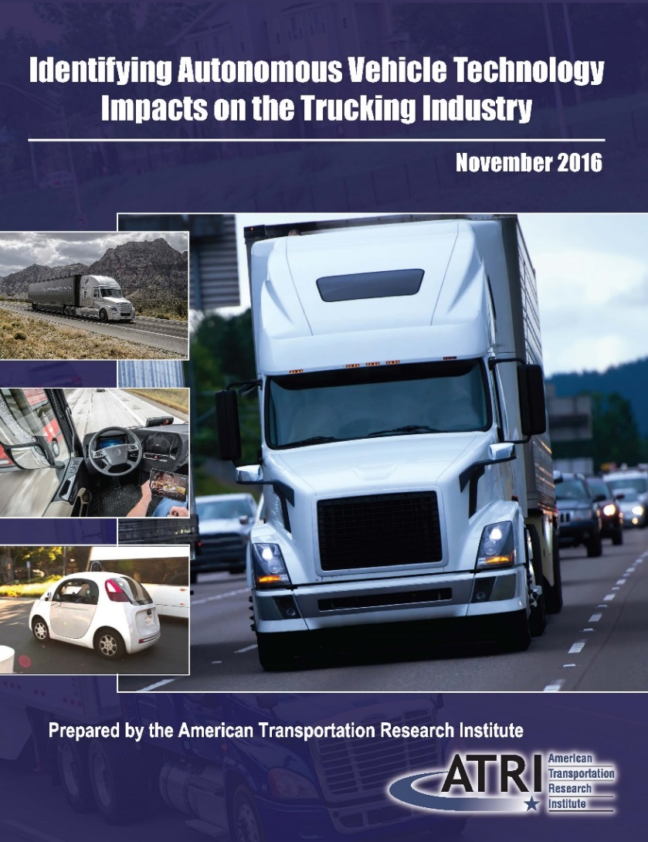
Autonomous Vehicle Technology Impacts
Maps AV impacts to trucking industry’s top concerns
  Driver Shortage
  Driver Retention
  HOS
  Truck Parking
  Infrastructure
  Driver H/W

Slide 31
Potential Impacts on Top Issues
Top Issue | Key Autonomous Truck Benefit
Driver Shortage | Job more attractive with higher productivity, less time away from home, additional logistics tasks; fewer drivers may be needed.
Driver Retention | Companies with autonomous technology may attract and retain drivers.
Hours-of-Service | Allows for driver rest and productivity to occur simultaneously.
Truck Parking | If “productive rest” is taken in the cab during operations, less time will be required away from home at truck parking facilities and will reduce demand for truck parking capacity.
Infrastructure / Congestion / Funding | Urban congestion could be mitigated through widespread use of autonomous vehicles (including cars).
Driver Health and Wellness | Driver could be less sedentary; could reduce stress of driving.

Slide 32

Marijuana Legalization and Impaired Driving
Top RAC priority 2018
Identifies issues and solutions for addressing marijuana-impaired car drivers
  Roadside detection
  Testing challenges
  Judicial training

Slide 33
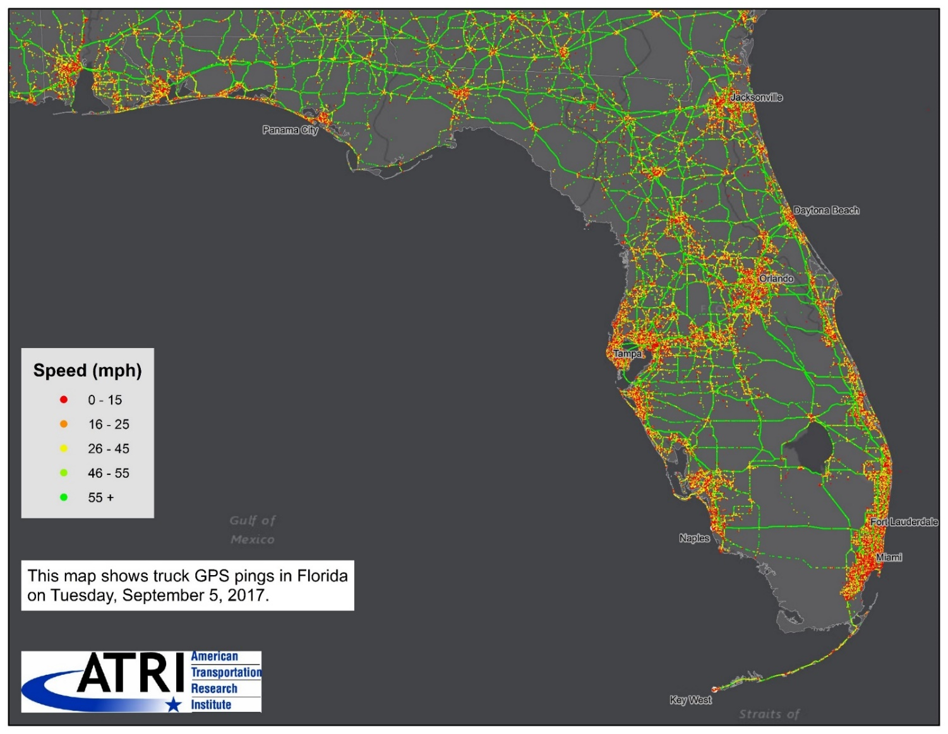
Hurricane Irma – Truck Activity

Slide 34
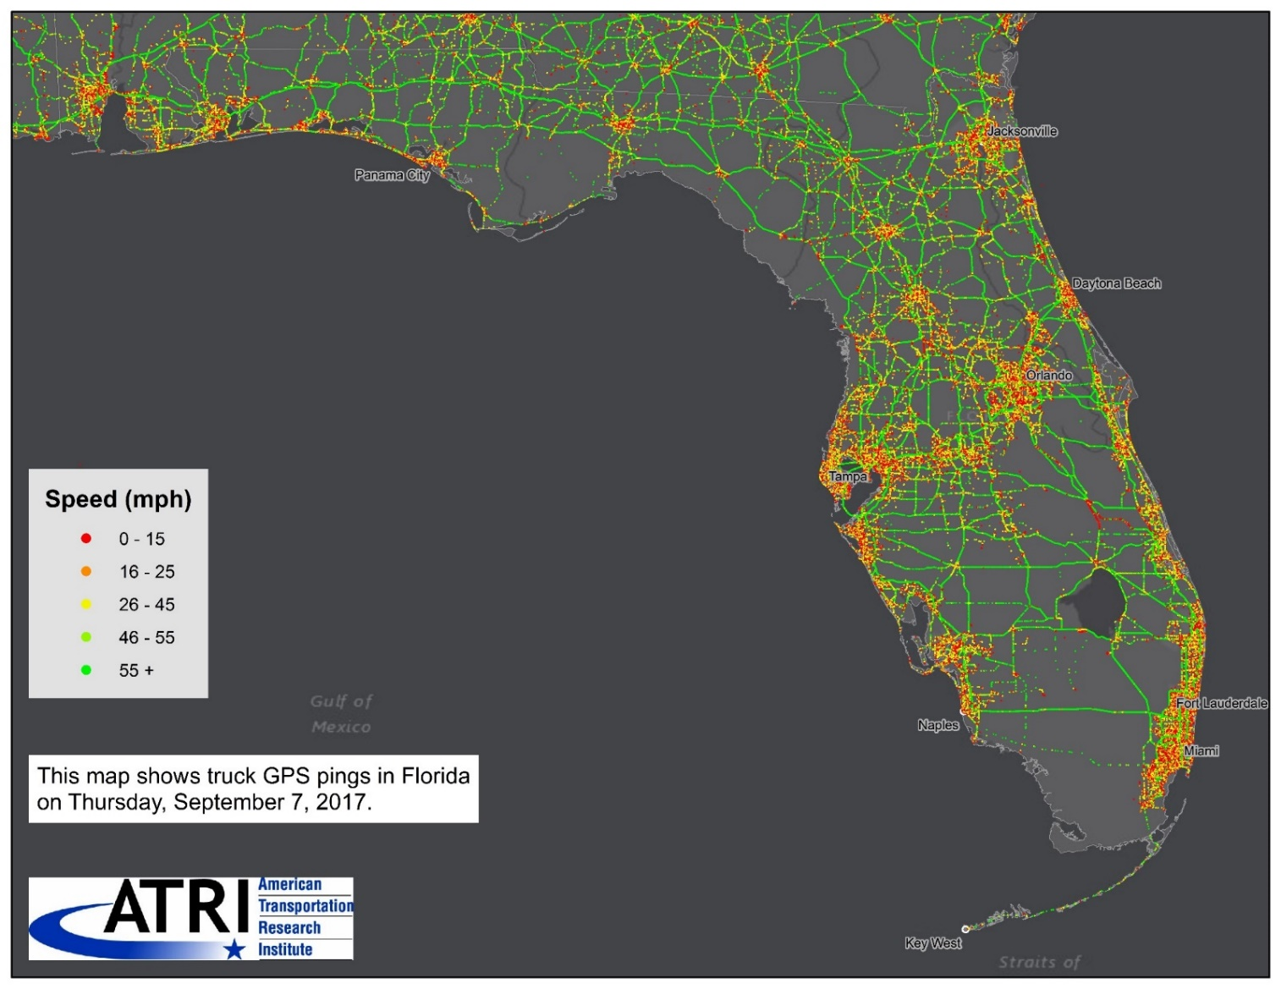
Hurricane Irma – Truck Activity

Slide 35

Hurricane Irma – Truck Activity

Slide 36
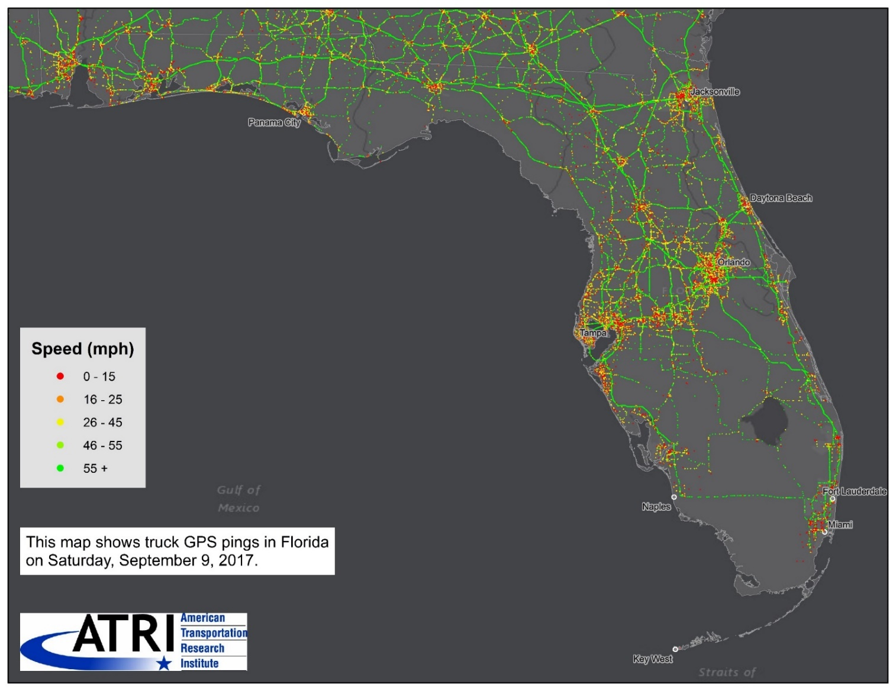
Hurricane Irma – Truck Activity

Slide 37
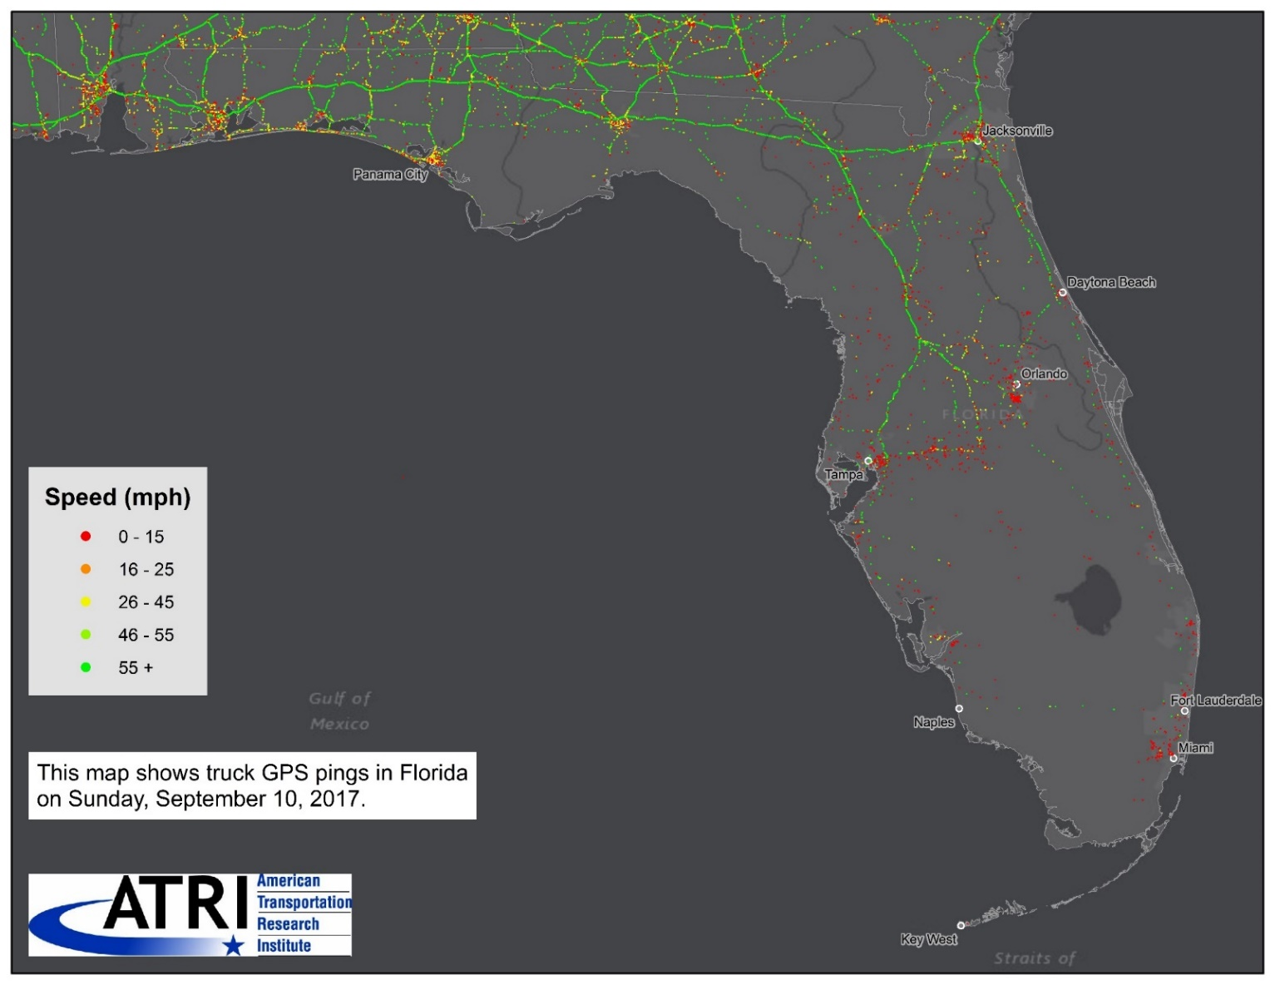
Hurricane Irma – Truck Activity

Slide 38
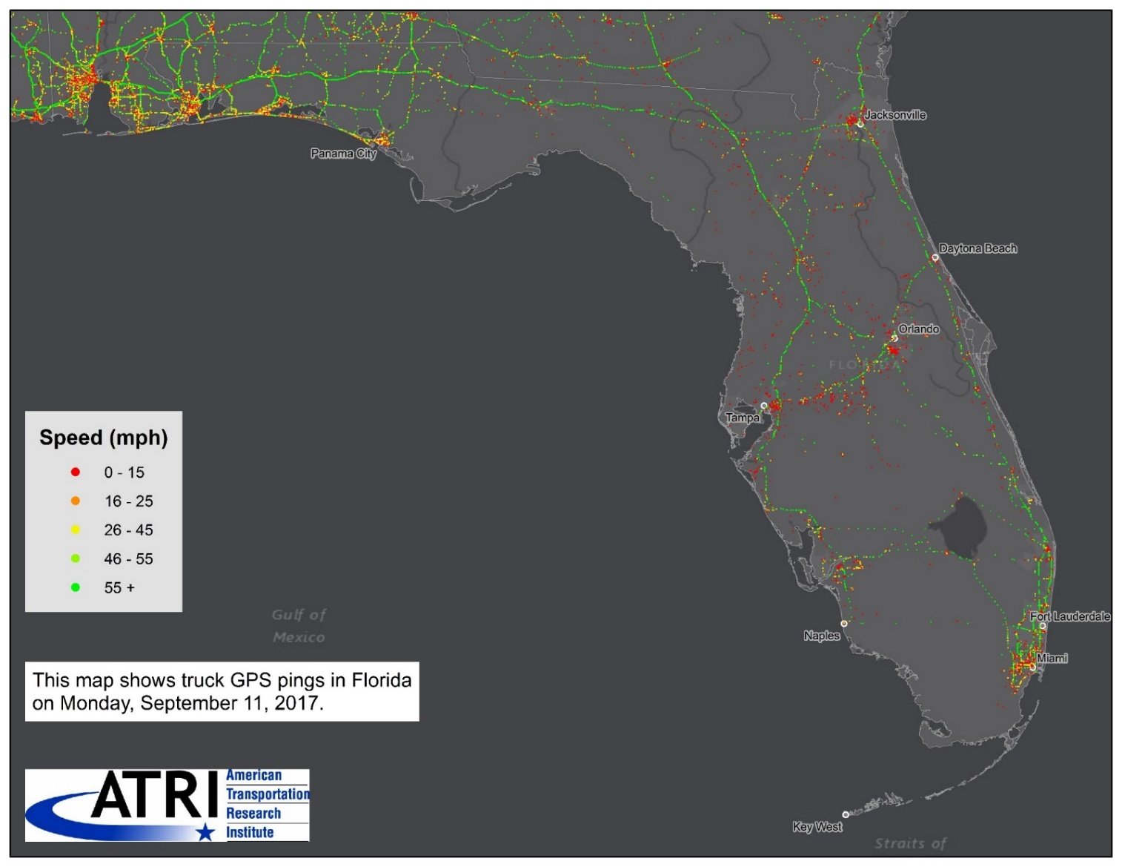
Hurricane Irma – Truck Activity

Slide 39
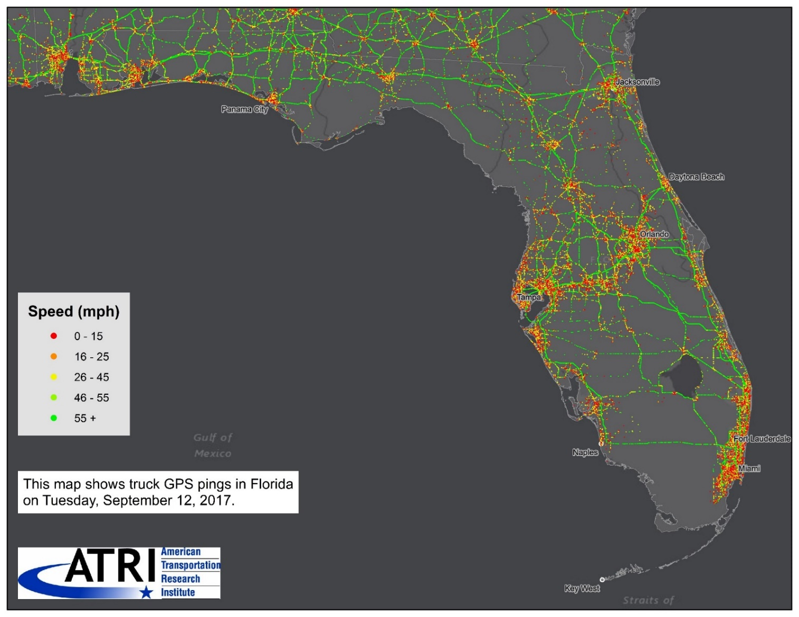
Hurricane Irma – Truck Activity

Slide 40

Questions?
Rebecca Brewster
rbrewster@trucking.org
770-432-0628
www.TruckingResearch.org
@Truck_Research
@ATRIPREZ

